Slide 1


Skills for Resilient Regions
Nordregio Forum 2019 27 & 28 November
Harpa, Reykjavík

Slide 2



Slide 3
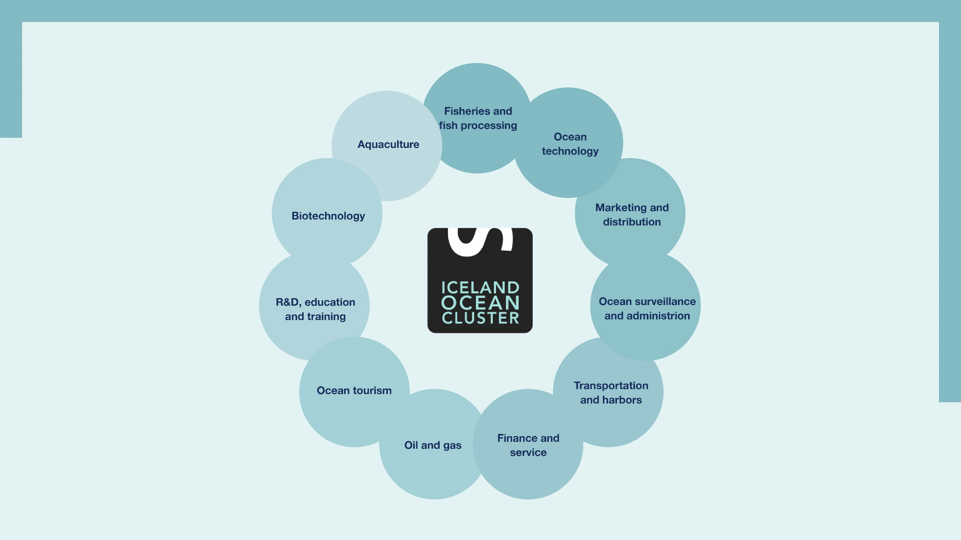

Slide 4


Slide 5
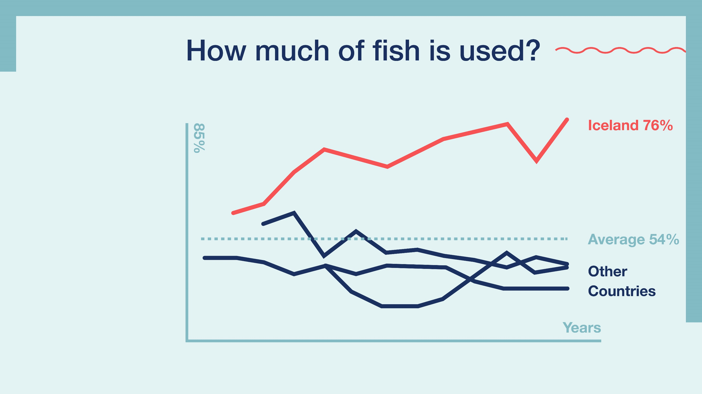

Slide 6
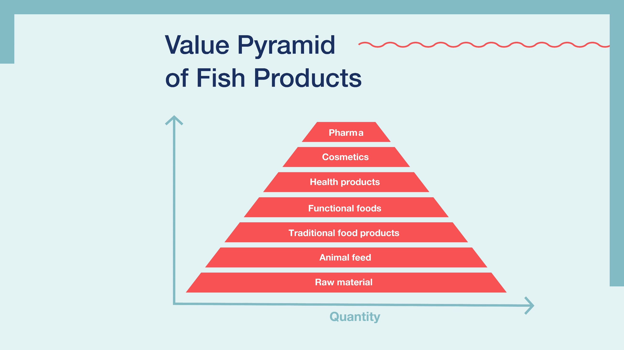

Slide 7
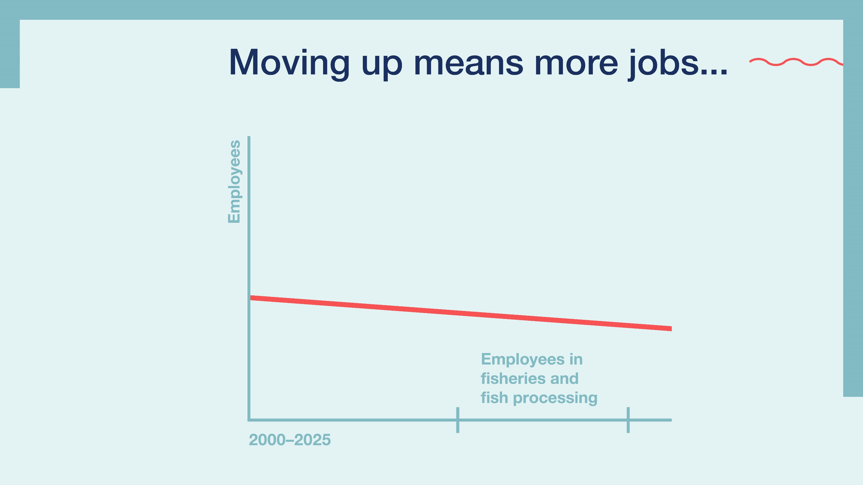

Slide 8
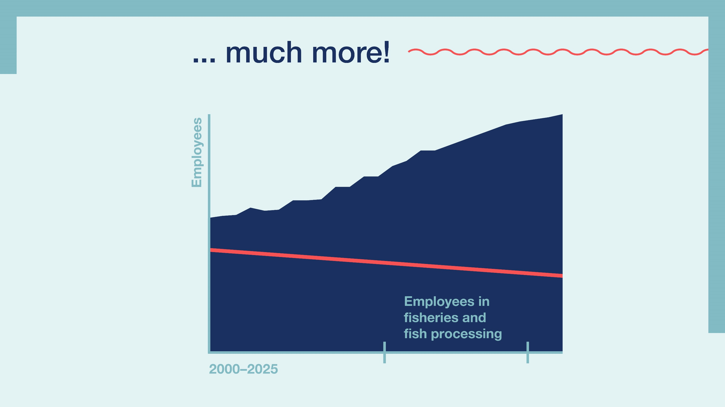

Slide 9
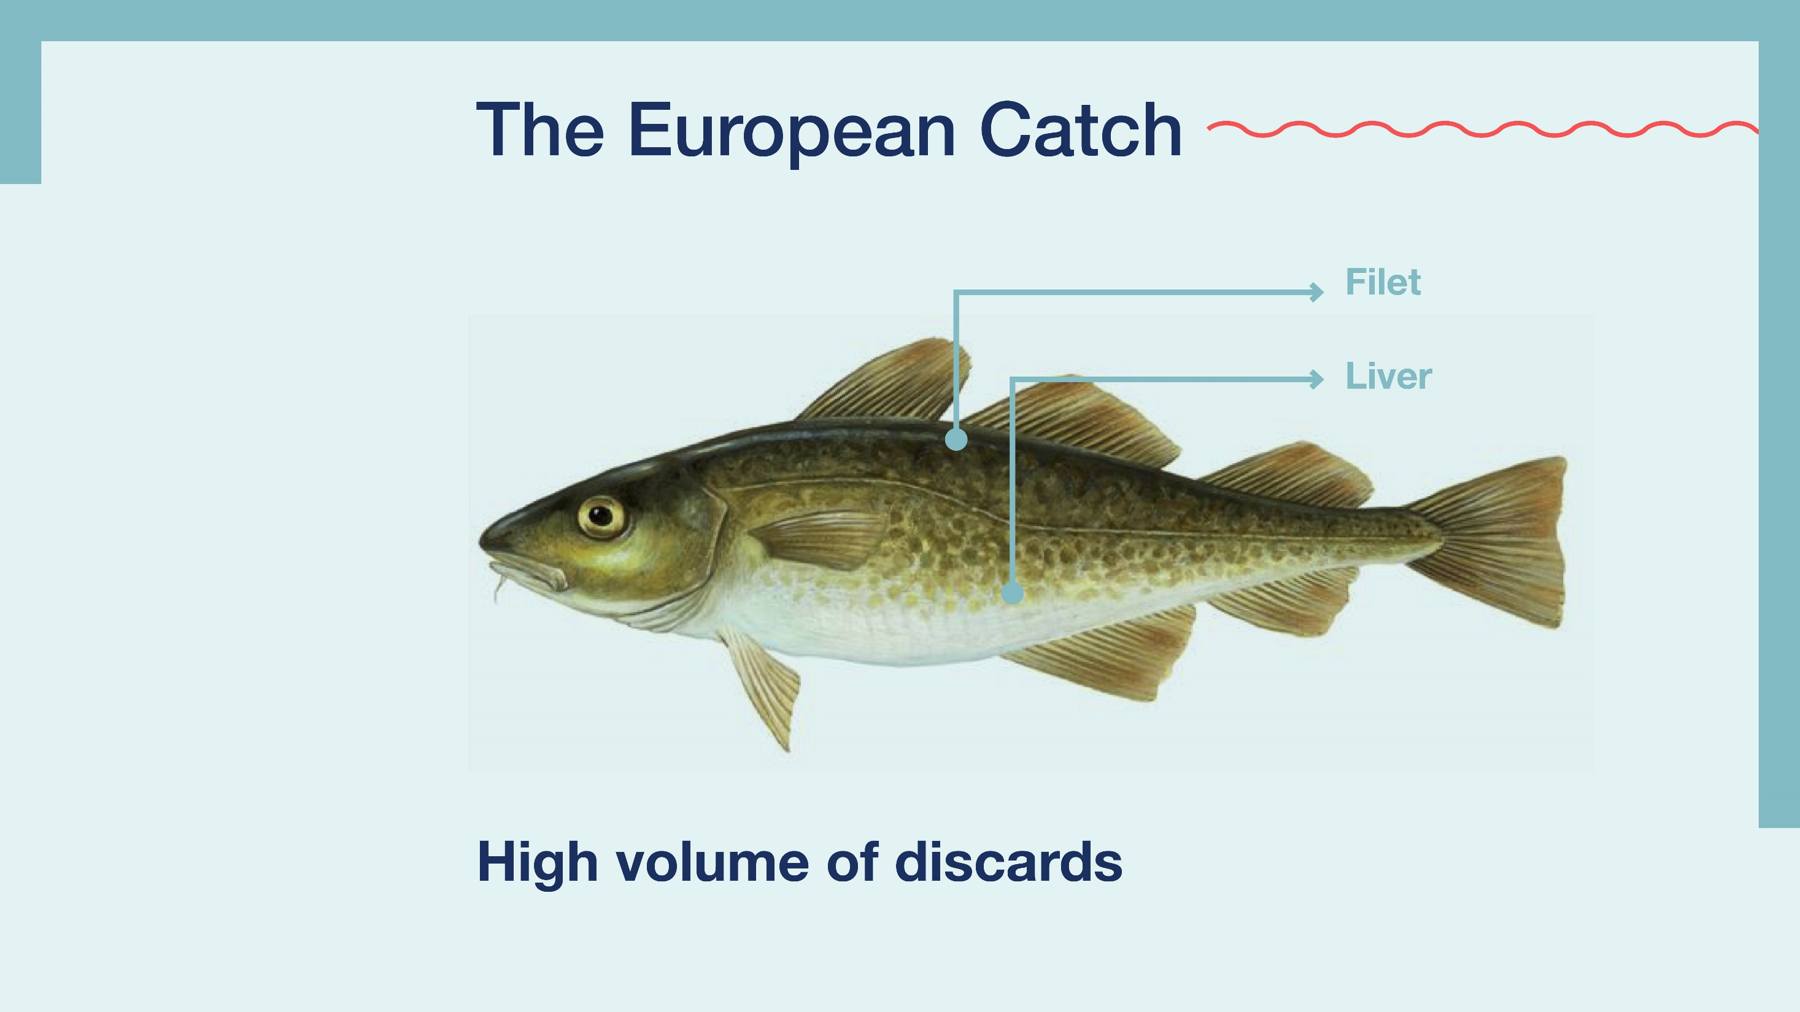

Slide 10


Slide 11
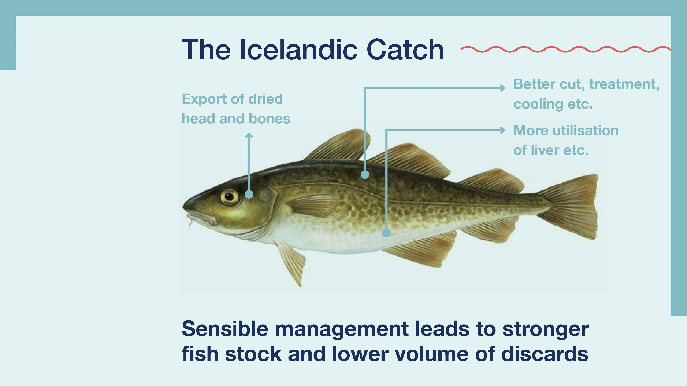

Slide 12


Slide 13
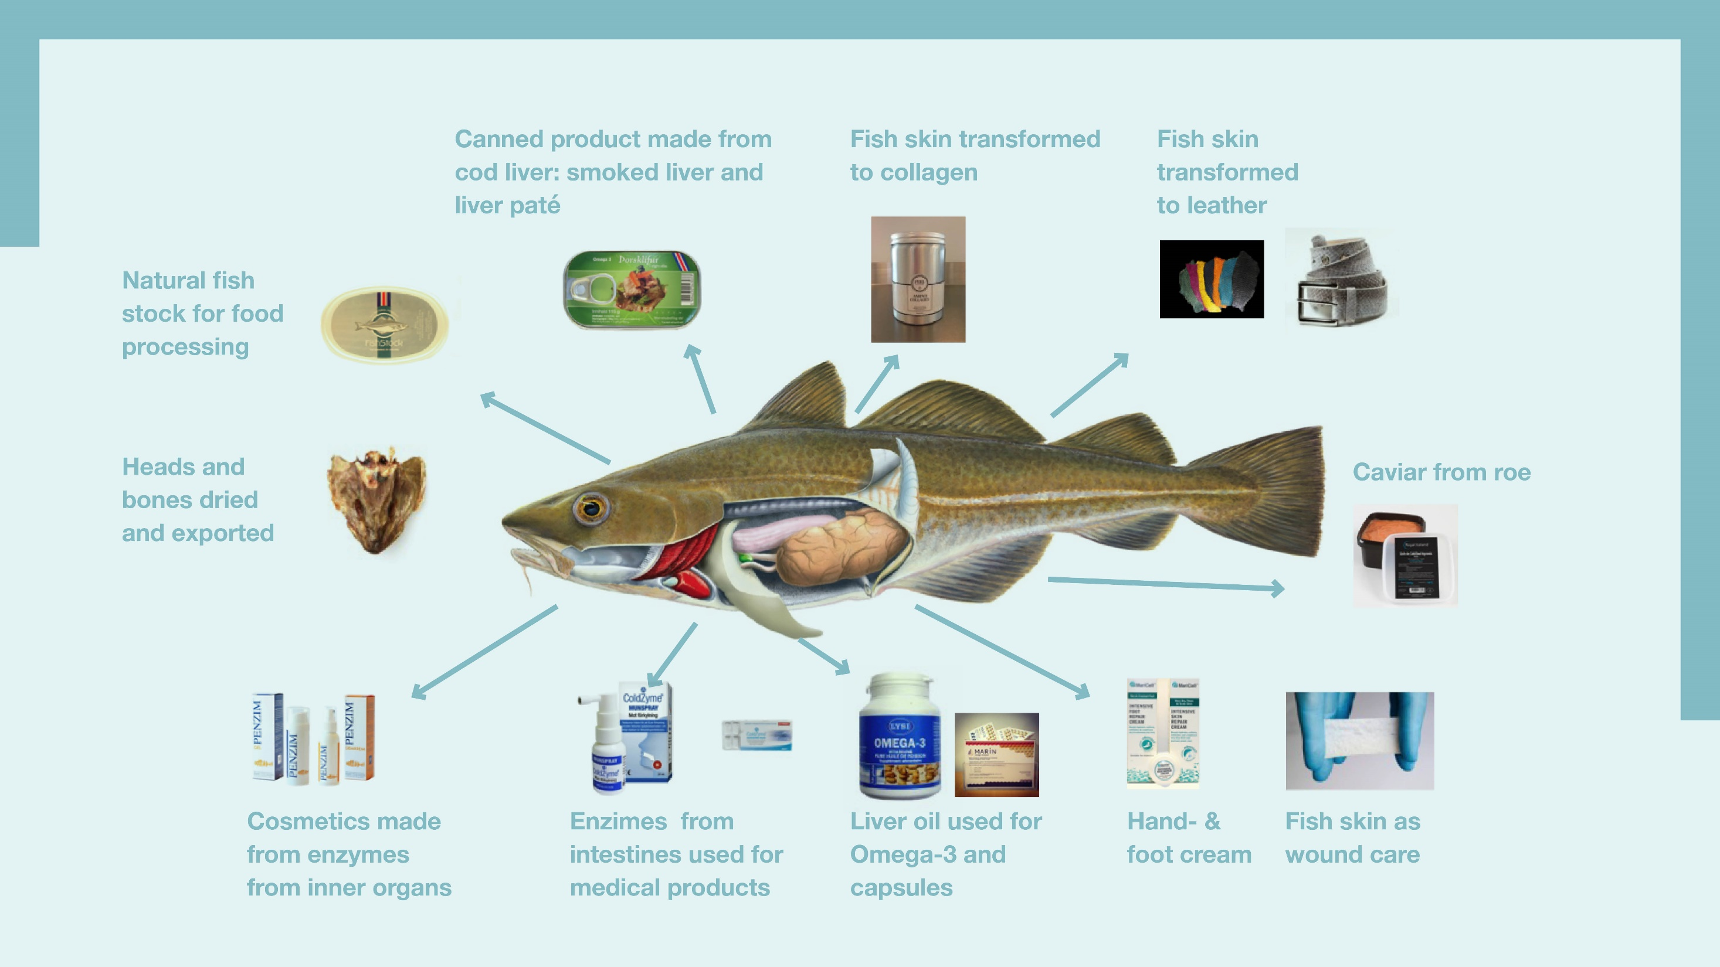

Slide 14
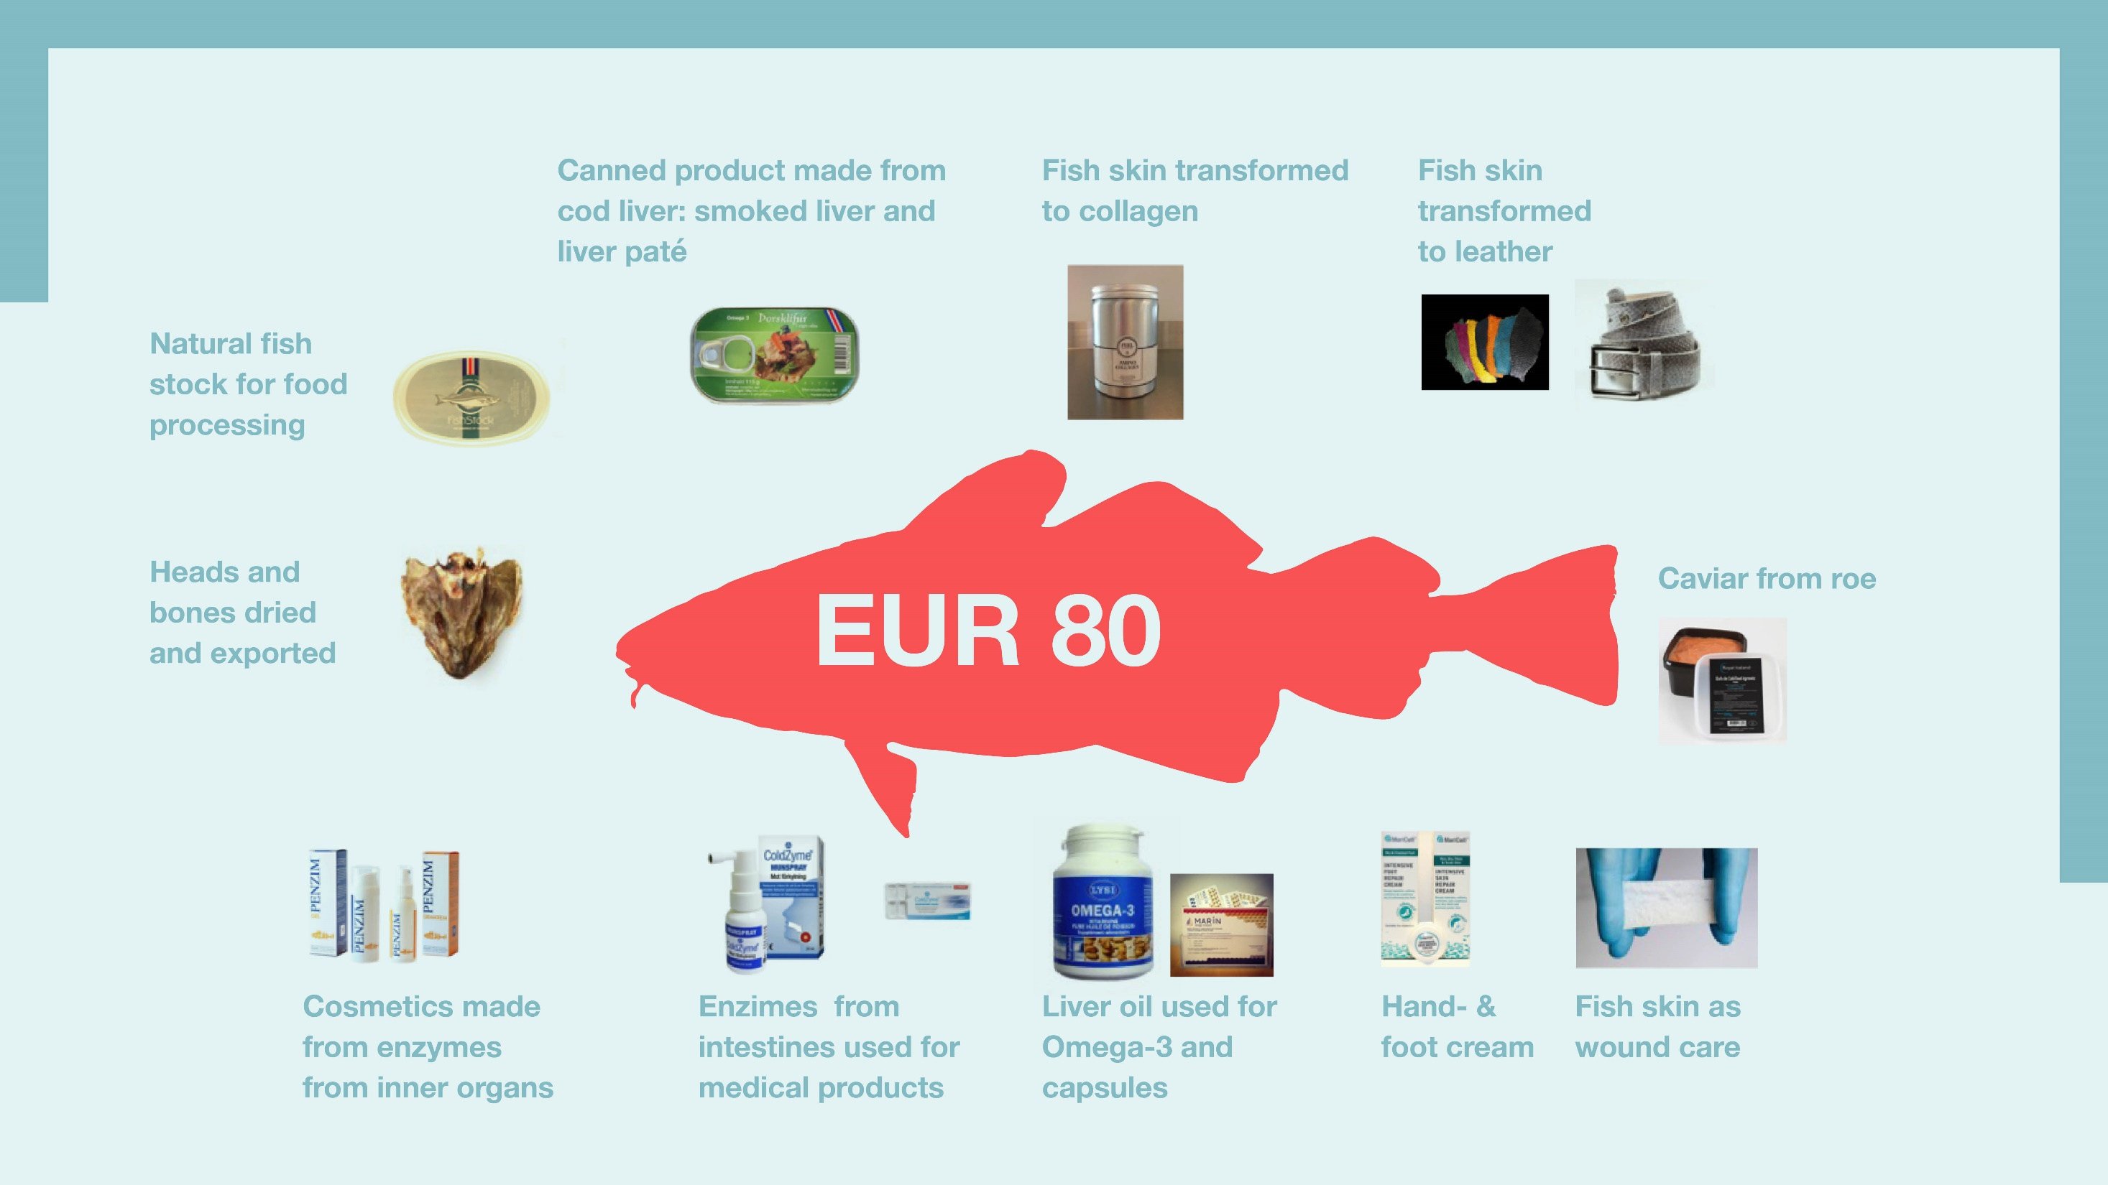

Slide 15


Slide 16
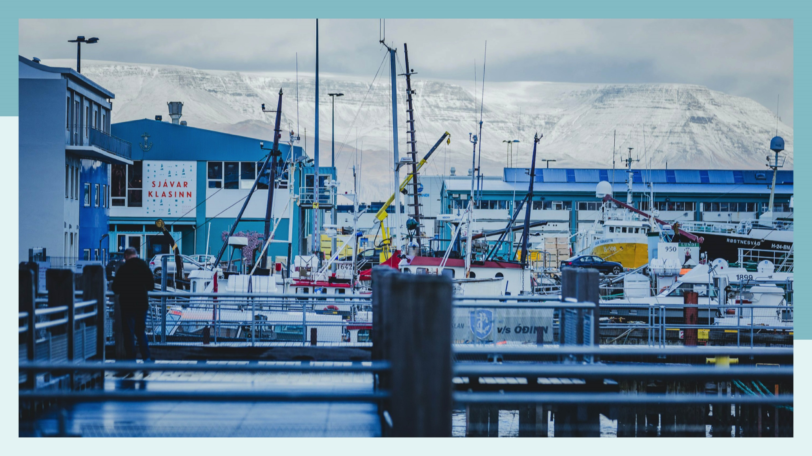

Slide 17
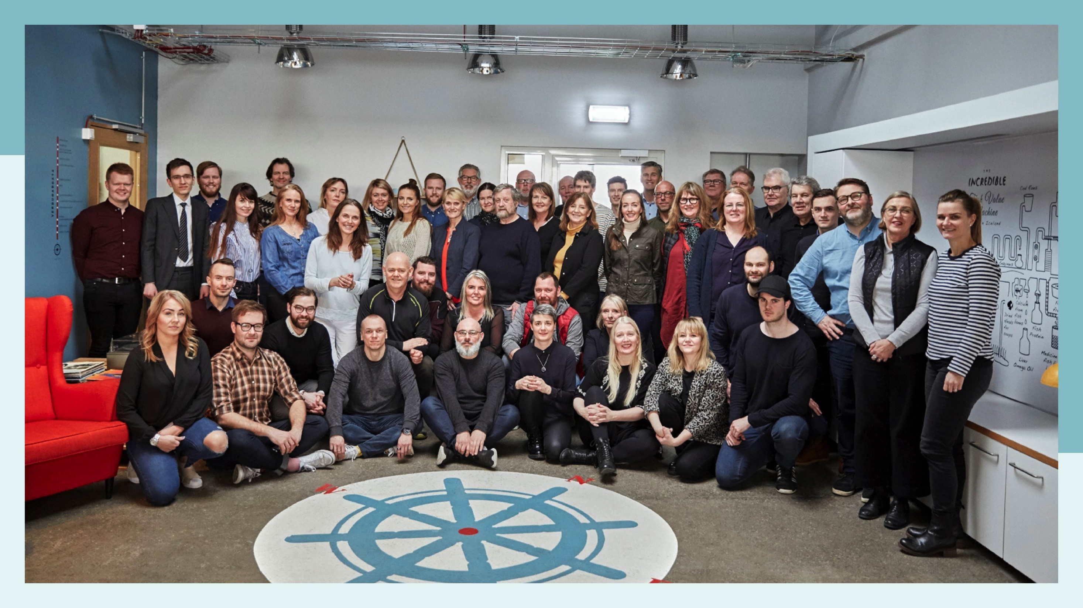

Slide 18


Slide 20

















Slide 21

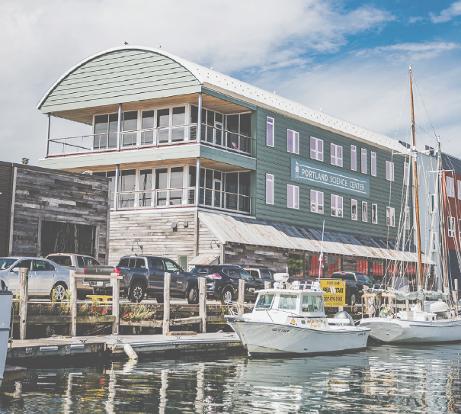

Innovation hub opening in Maine

Slide 22

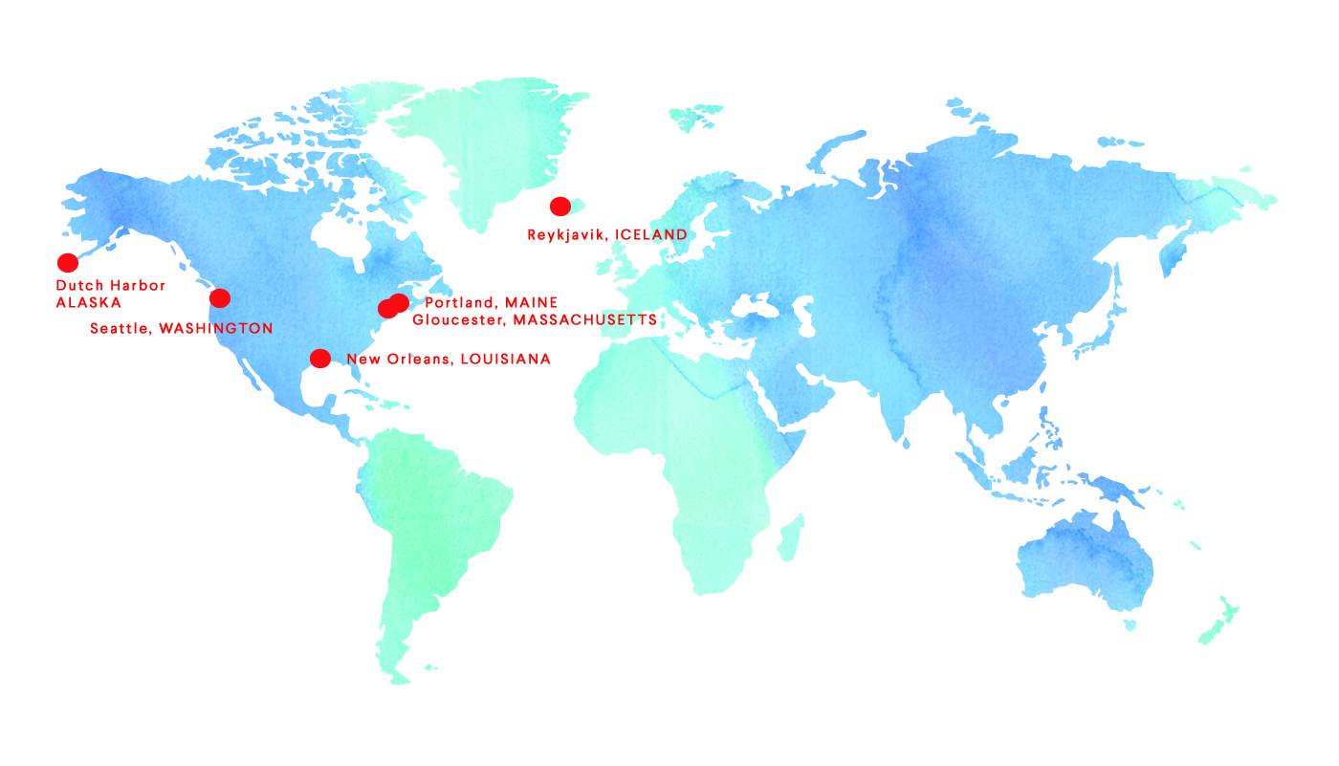
^{Innovation hubs}
Next on the agenda: Innovation hubs
in Nordic ports

Slide 23
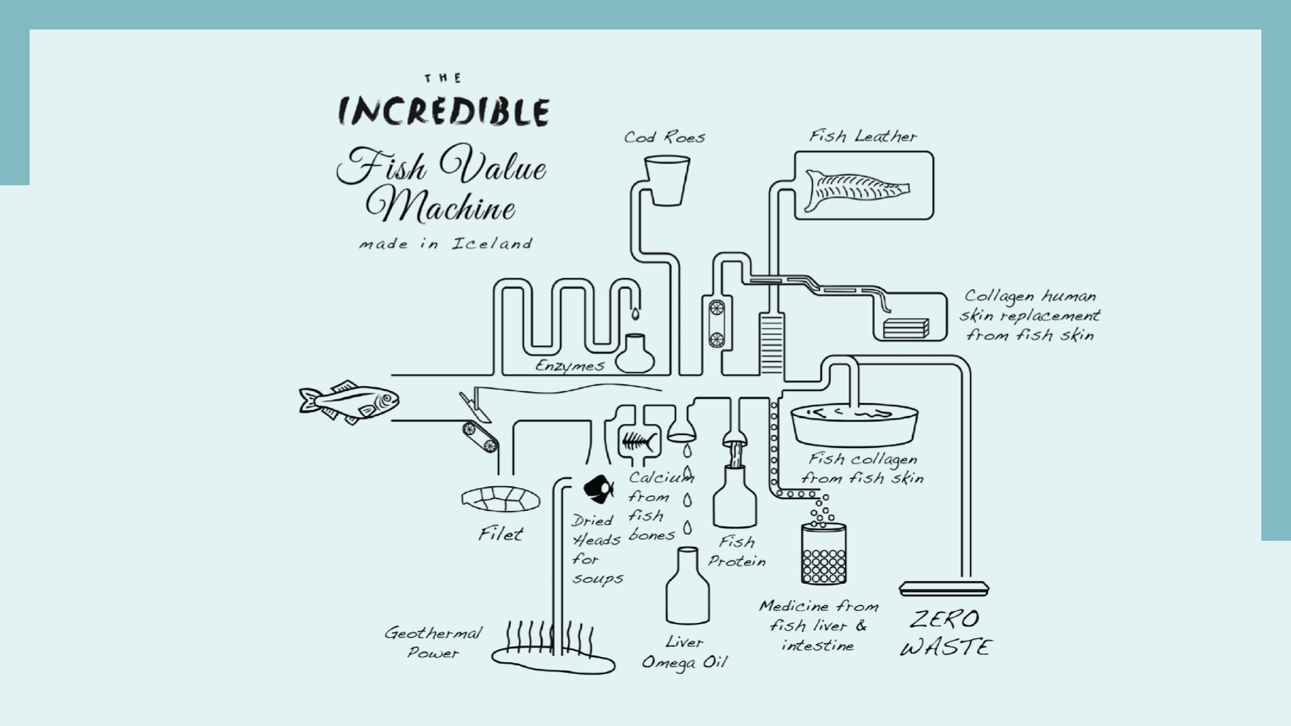

Slide 24


Slide 25


