Slide 1
VISIT FAROE ISLANDS

Slide 2
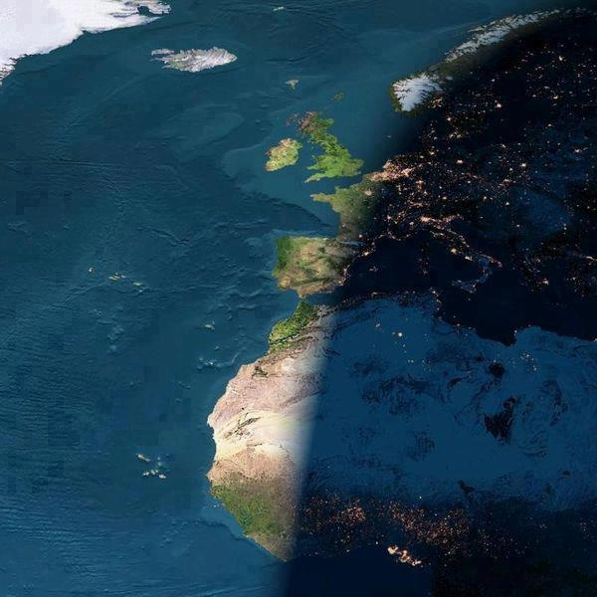

Slide 5
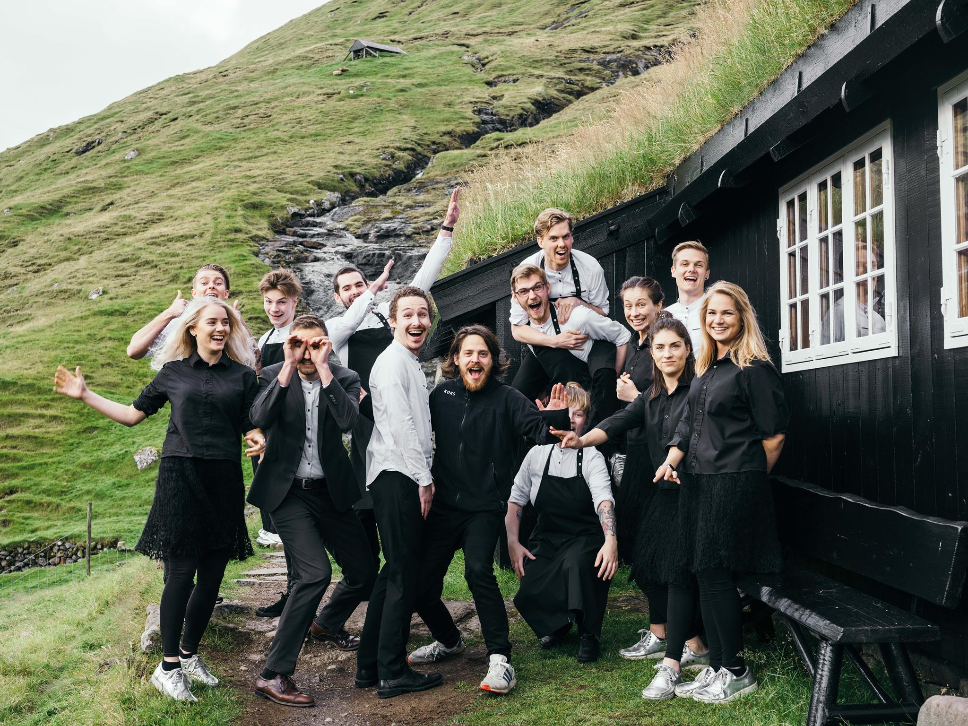

Slide 6
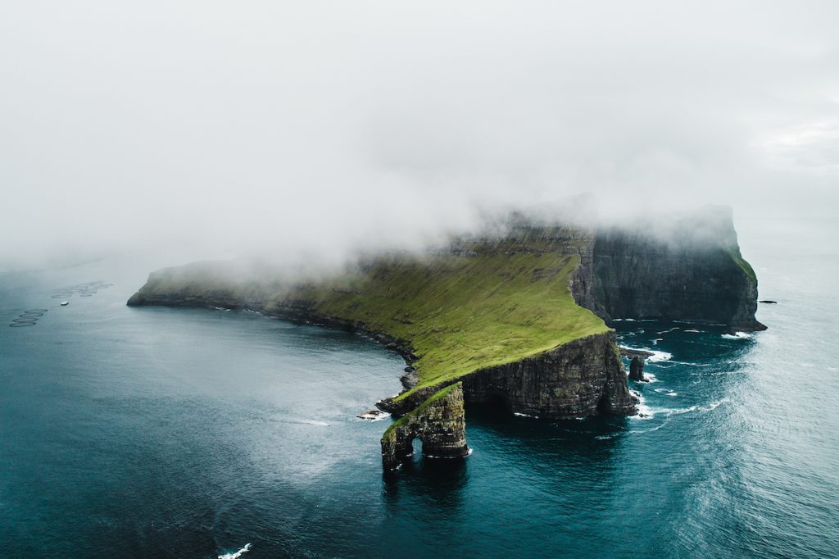

Slide 8
4 CORNERSTONES LEADING TO 2025
#1
QUALITY OVER QUANTITY
#2
TOURISM FOR ALL OF THE FAROE ISLANDS, ALL YEAR ROUND
#3
KNOWLEDGE AND PROFESSIONALI-SATION
#4
A COMMON LEGISLATIVE FRAMEWORK

Slide 9
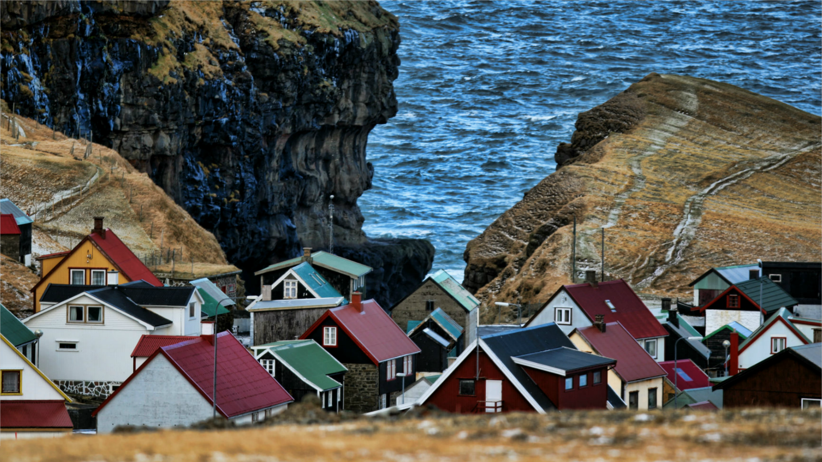

Slide 10
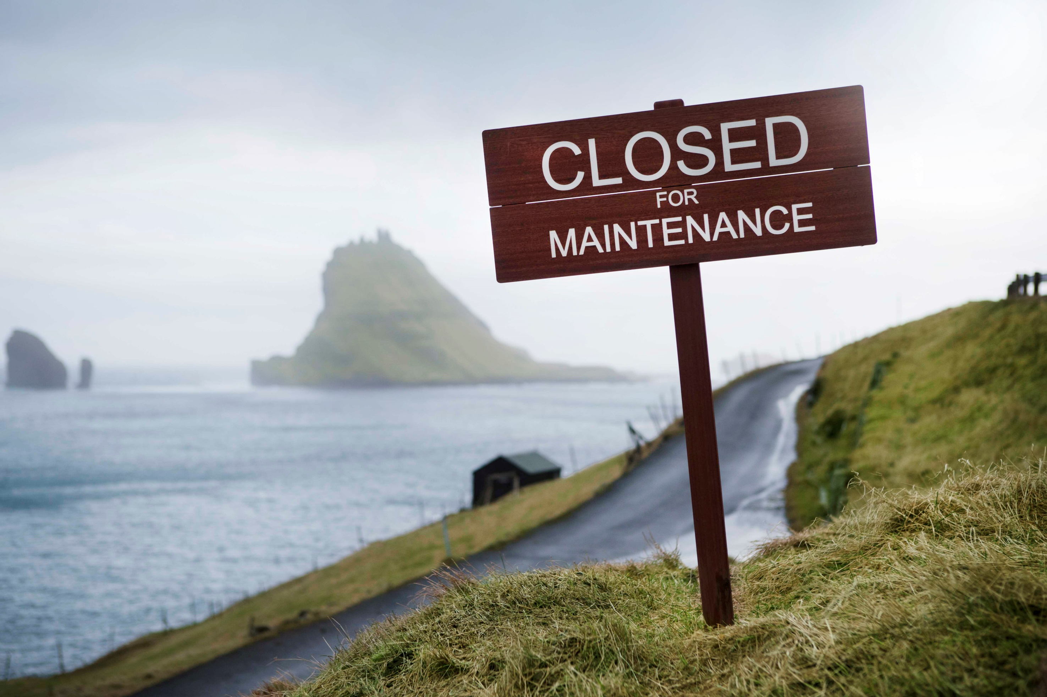
CFM mynd

Slide 11
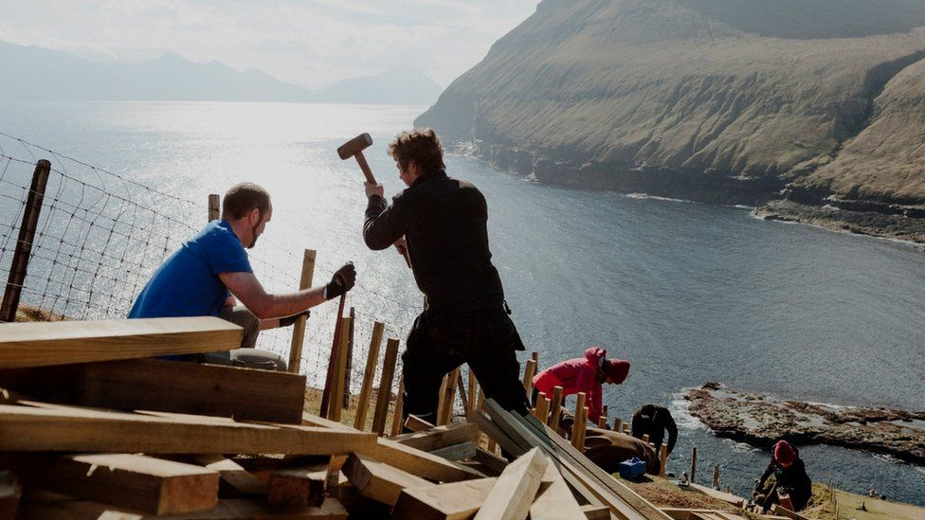
TOURISTS: A part of the solution, rather than the problem

Slide 12
Cannes
Thanks

Slide 13
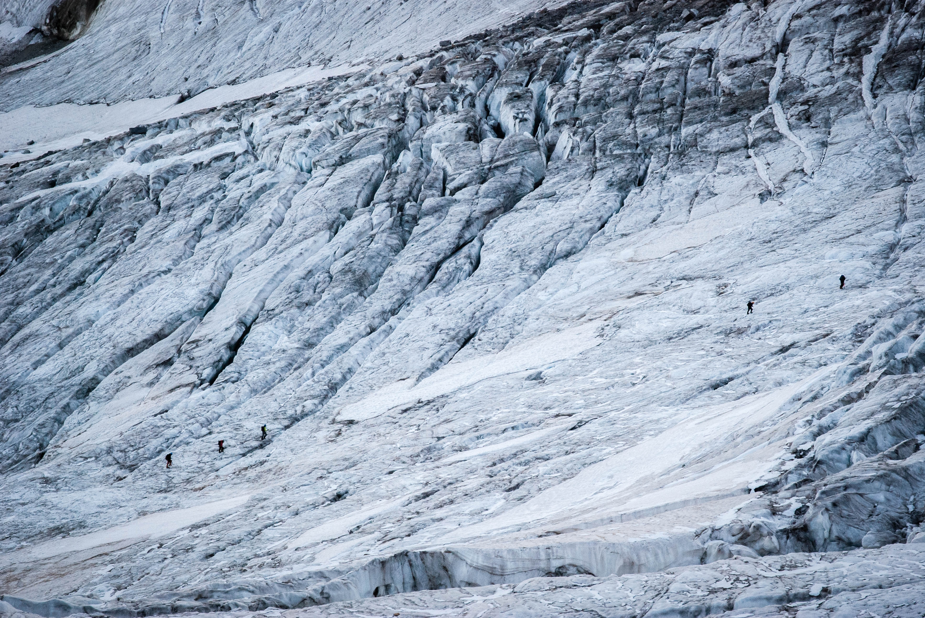
Kjell Nilsson

Slide 14
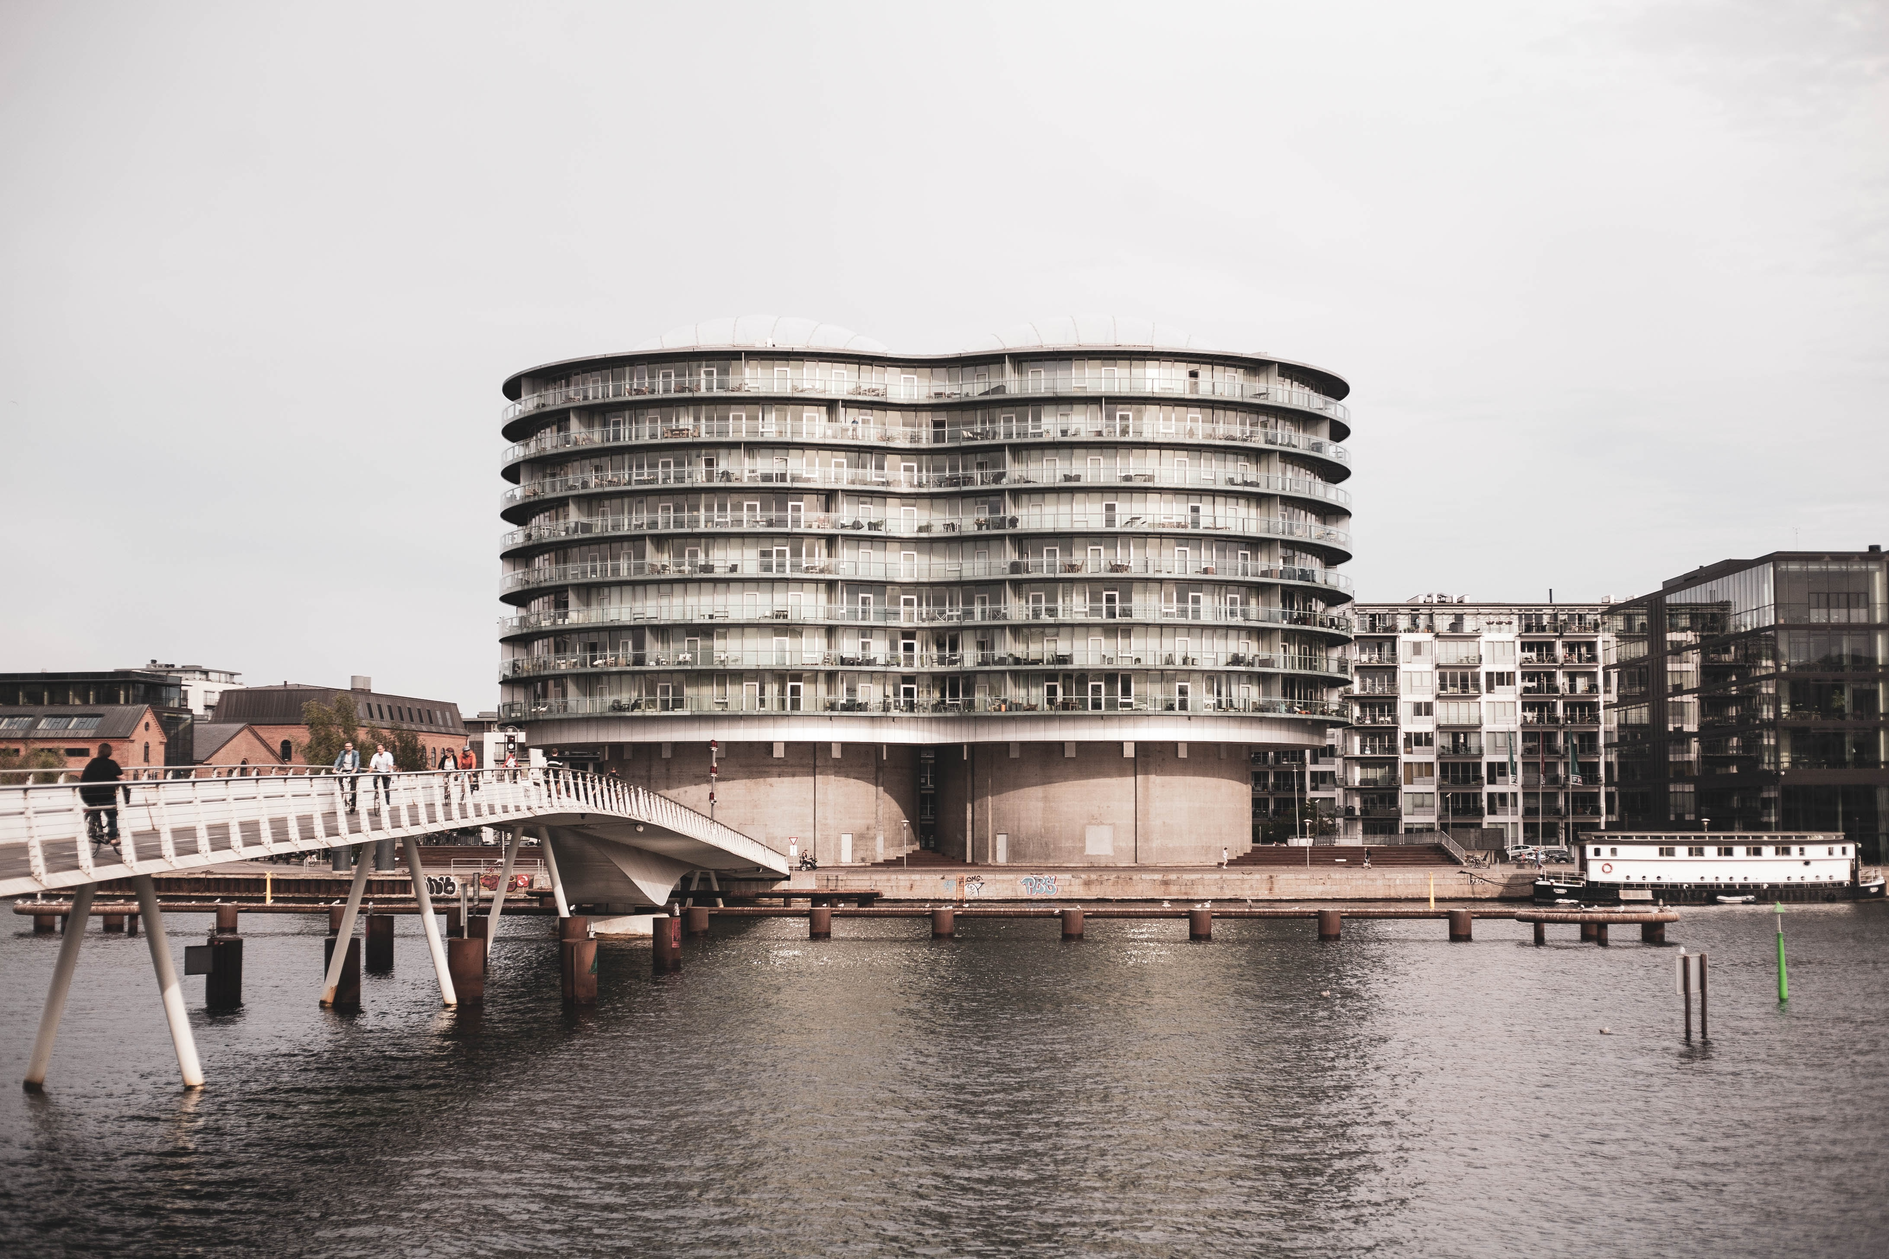
Save the Date! Nordregio Forum 2020 Copenhagen 25 – 26 November 2020

