Slide 1
Smart specialisation in Åland

Slide 2
Characteristics of a thriving region
Low unemployment
Increasing population
High investment pace
Attractive place to live
Healthy & happy people
Resilient – ability to rebound
Manages digital transition successfully
Takes sustainability challenges seriously
Smartly specialised

Slide 3
Åland - descriptives
Very low unemployment rate & high participation rate
Growing population – positive neg migration
Passenger and freight shipping stand for 20% of GDP - low share of manufacturing, high share services – tourism important
High GDP per caipita, but today’s GDP lower than in 2007 - a lost decade of growth
Many small companies without growth ambitions – few large companies
Polytechnic university with only bachelor level studies – limited resources for research
Highly educated personnel has to be ”imported”
Very low R&D expenditure & low productivity growth
Innovation activities mainly other than R&D
Enterprises used to cooperating with each other
Cross-sectoral cooperation is constantly looking for a new formula - many initiatives have died out quietly
Segmented labour market - traditional gender roles - conservatism
Specific barriers of entry – curbs competition and FDI

Slide 4
Åland suffers from an increasing deficit of young women

Slide 5
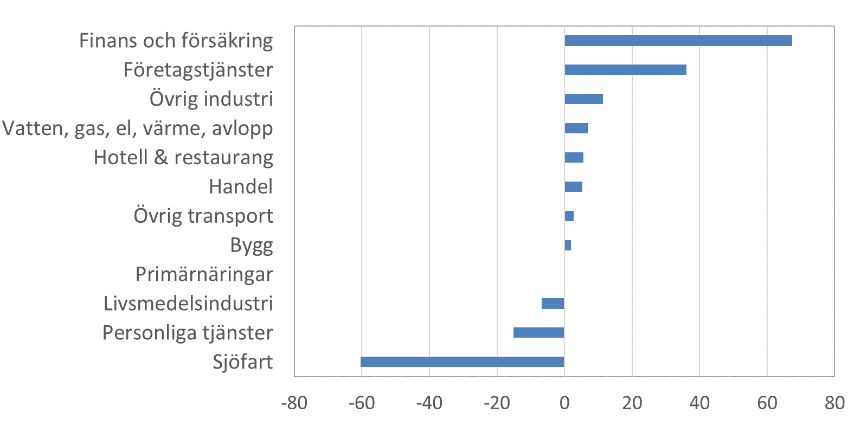
Growth within the private sector 2008-2016, million euro in 2016 prices

Slide 6
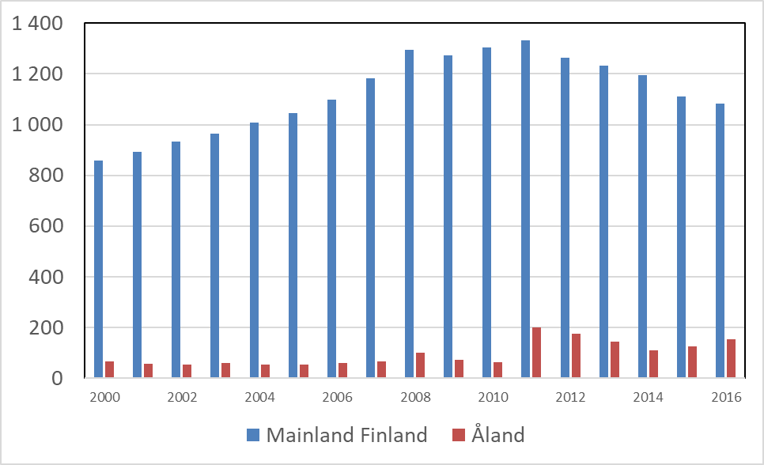
R&D expenditure in Åland and mainland Finland, euro per capita
Source: Statistics Finland

Slide 7
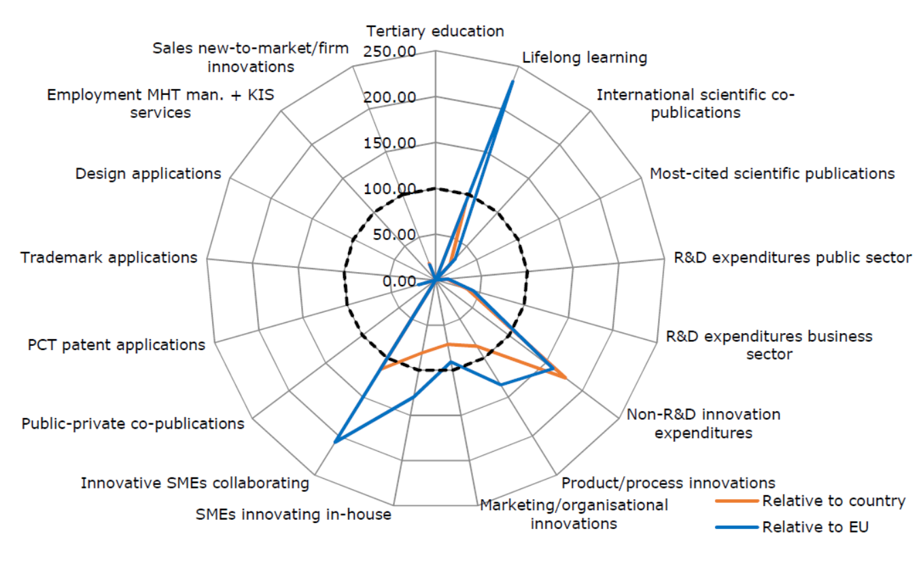
Innovation activities in Åland
Source: EU Regional Innovation Scoreboard 2019

Slide 8
S3 in Åland
Smart specialisation a part of Åland’s innovation strategy 2014-2025
Skills policies announced to support S3
Practical orientation towards commercial innovations
ERUF&ESF financing important
Focus on land-based but shipping-related activities (banking, insurance, IT, tourism) + health care
Overarching goal to steer Åland towards sustainable growth

Slide 9
Activities of Åland’s S3
Risk capital fund
Support for newly established businesses
Flexible and relevant education within enterprises
Research and innovation funds-> Åland Polytechnic
– 60% health care
40% IT & business studies
ESF-funded activities:
integration of newcomers through e g language training
Support for long-term unemployed

Slide 10
Challenges
Low demand for ERUF Risk capital financing
No common sense of urgency
Prisoner of past success – change is difficult
Lack of appetite for risk-taking
Weak higher education & R&D
Political in-fighting – reform initiatives are often critized, discarded or rolled back

Slide 11
What to do – personal reflections
Increased resources to the Polytechnic university – measures already on the way
Closer ties to HEIs outside Åland?
Reform domicile rules – Drop the 2/3 Ålanders manning requirement in company boards?
Enhance equal opportunities within working life – crush the glass ceilings?
Special support for migrants’ business ideas?
Revitalised reform leadership?

Slide 12
Thank you for your interest!

Slide 13
Värmland Smart Specialisation and how to maximise this policy tool
Anders Olsson, Manager of Smart Specialisation
Notes:
We must be outward looking, connect to global knowledge flow and value chains.
Create luck, expose your self for many opportunities.
Cluster from a governmental perspective
We passed a milestone on the 15th of June 2006.
Örjan Sölvell, Stockholm School of Business.

Slide 14
Värmland Smart Specialisation and were it has brought us
Anders Olsson, Manager of Smart Specialisation
Notes:
We must be outward looking, connect to global knowledge flow and value chains.
Create luck, expose your self for many opportunities.
Cluster from a governmental perspective
We passed a milestone on the 15th of June 2006.
Örjan Sölvell, Stockholm School of Business.

Slide 15
Notes:
First a brief on the Värmland RIS3
”… a dynamic strategic process where regions and Member States identify their long term competitive advantages based on local strengths, and define those actions that can lead them to maintain and/or create their competitive postition”
Källa: Innovation Union Competitiveness Report, 2011

Slide 16
Value-Creating Services
MARKET
Forest-based Bioeconomy
RESEARCH
PRIORITIES
Digitalisation of
Welfare Services
Advanced Manufacturing
and Complex Systems
Place Based
Digitalised Experiences
System Solutions
With Photovoltaics
Gender Integration
BUSINESS STRUCTURE
Notes:
This is how we summarise our RIS3.

Slide 17
Clusters as engines in smart specialisation and the Entrepreneurial Discovery Process
Notes:
Now we have a model where the clusterorganisations facilitates a corresponding thematic platform and hence are drivers for entrepreneurial discovery processes.
One up side to this is the potential of the involvement of the business side / the industry in the EDP. A risk is a lock in effect if companies
One risk is if there will be lock-in effects while companies defend their short-term interests.

Slide 18
Two out of seventeen Vinnväxt winners from Värmland 10 years of funding
Notes:
This is our strongest connection to the national innovation support system.
The DigitalWell Arena started this year and av 10 years a head of them…

Slide 19
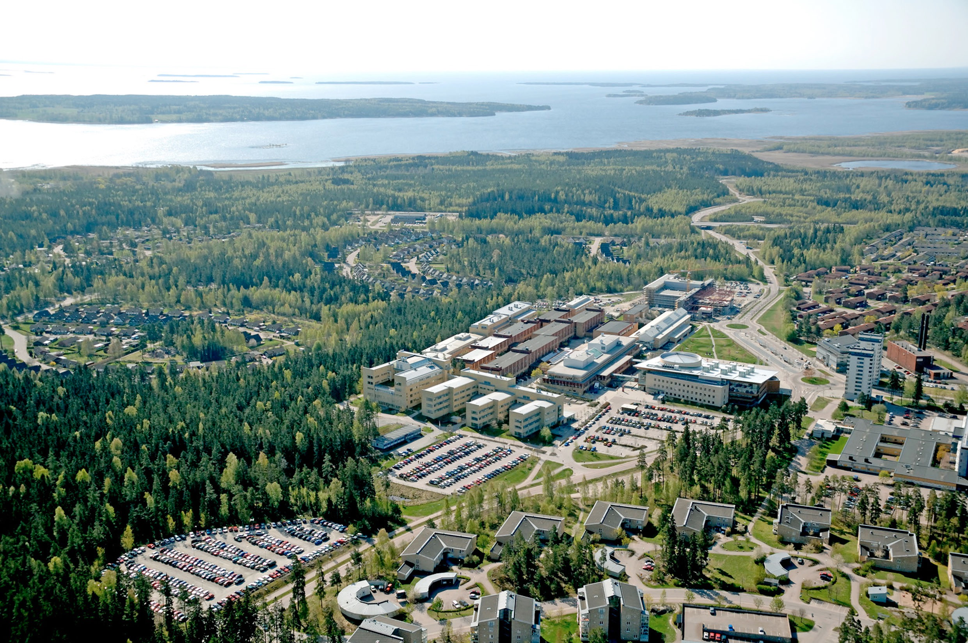
Karlstad University
a partner in smart specialisation
Notes:
OECD-projektet har varit avgörande för att utveckla Kau till ett framgångsrikt samverkansuniversitet.
”Highest grade from Vinnova” ? är det i de så kallade samverkanspiloterna ? Här måste det nog tydliggöras vad som menas! Dessutom så var det ju en lite invecklad ”betygsskala” vi landade på 5 av 6 möjliga poäng. Ska detta presenteras måste nog den som gör det vara insatt i vad det handlade om.
- Horizon-siffran måste även den tydliggöras, förmodar att det är success-raten som åsyftas. Den var 32% (11 av 34 ansökningar fick OK) under fas 1.
- Highest grade from dep of education, vad menas här? Är det utbildningsdepartementet ? För det första så heter det ju Ministry of Education and Research, men framförallt vad är det för ”grade” som tas upp ?

Slide 20
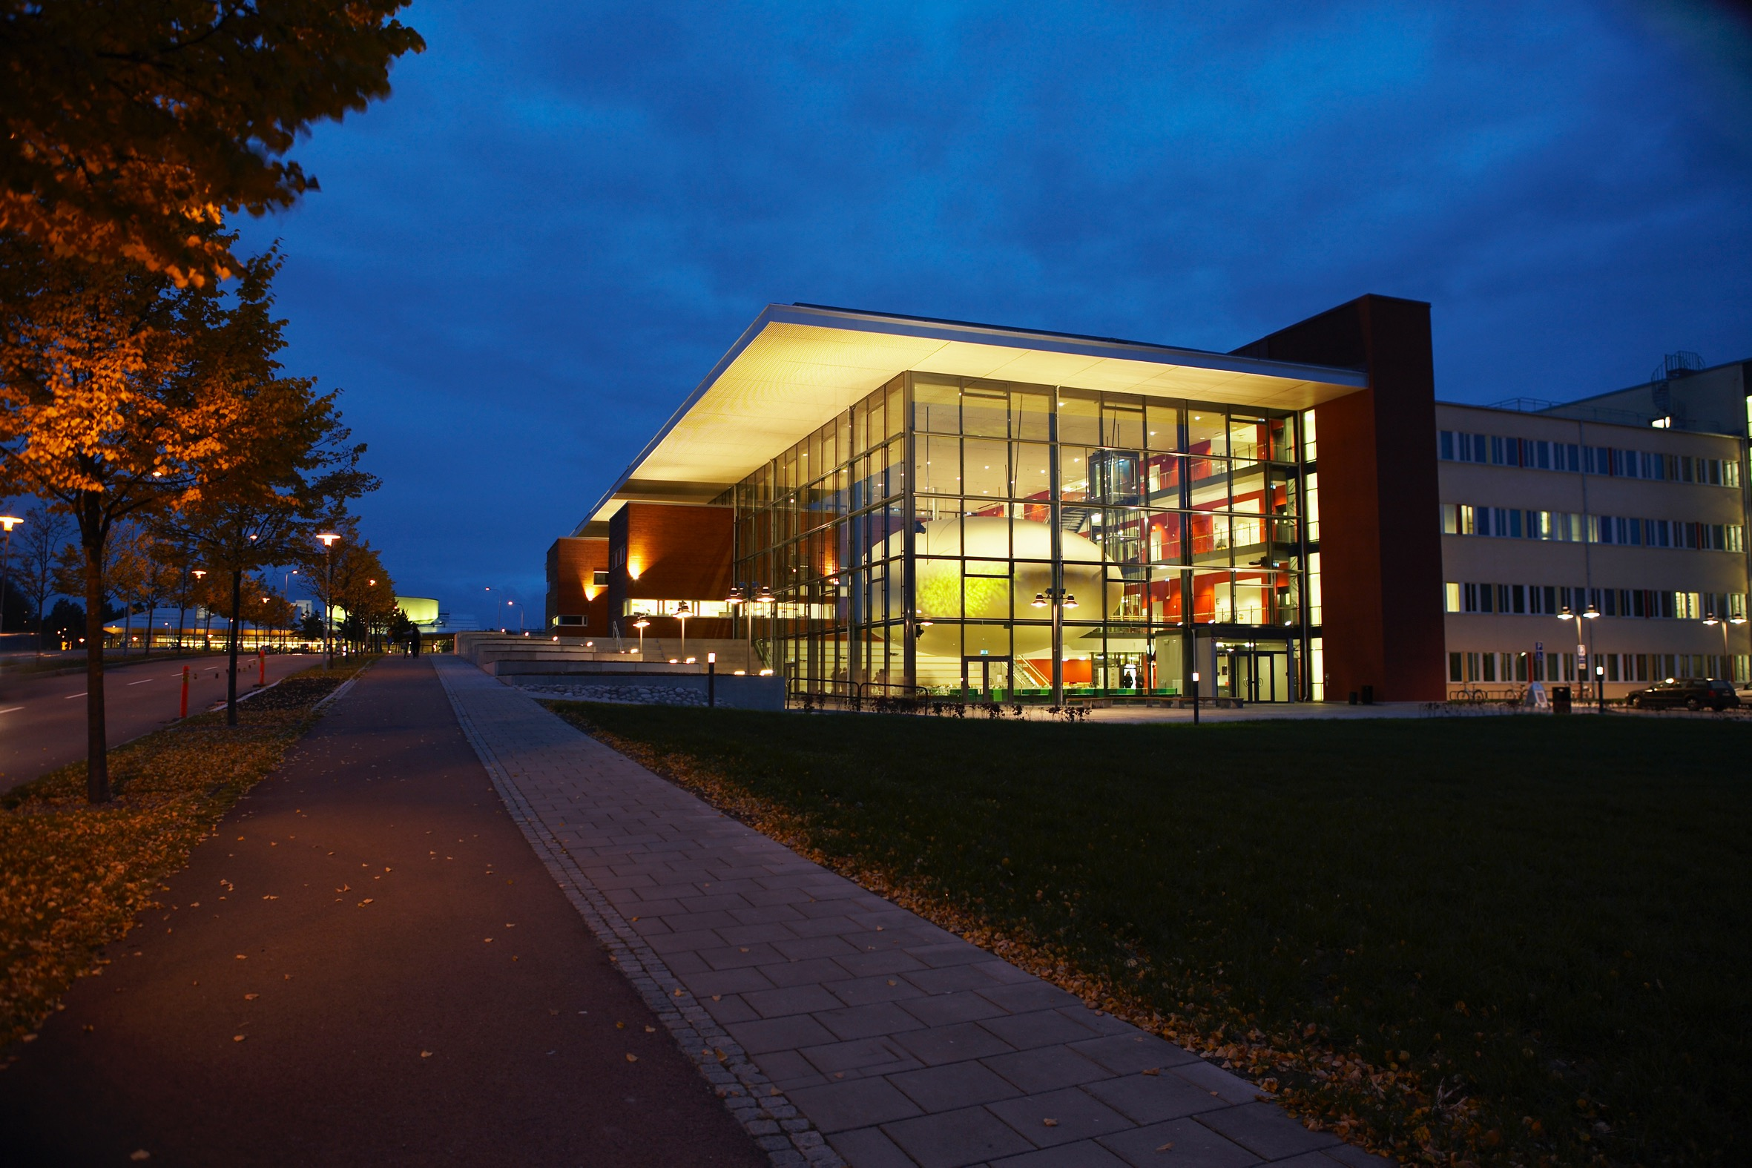
The Academy for Smart Specialisation
Notes:
A joint initiativ between the university and the region.

Slide 21
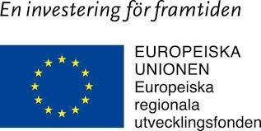
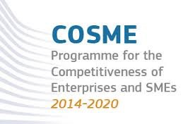
Funding Model Akademy for Smart Specialisation 2016-2020
5 million €/$ from Region Värmland.
6,5 million €/$ from från Karlstad University
5 million €/$ from external funding
Totalt: 16,5 million €/$
… and 20 million €/$ in related project funding

Slide 22
Marek Przeor from European Union, DG Regio:
The Academy for Smart Specialisation is a best practice in Europe on how you can connect universities to smart specialisation.
You have managed to do this more tangible thanks to the concept Academy for smart specialisation.

Slide 23
Will be evalutade by OECD and Nordregio in January 2020

Slide 24
Forest based bioeconomy – the highest prioritised specialisation of Värmland’s Regional Smart Specialisation

Slide 25
Profitability and growth in value added 2013-2018
Good profitability for most industries except Logistics.
Profitability Index
Growth in value added
Notes:
Pulp and paper have been doing well – well positioned on the market with board for packaging.
So do Engineering. But they have lost a substantial number of jobs. But at the same time Business Services has grown in number of jobs.
Logistics have a low profitability. Maybe due to competition from low cost countries in eastern Europe who operates on the roads here?

Slide 26
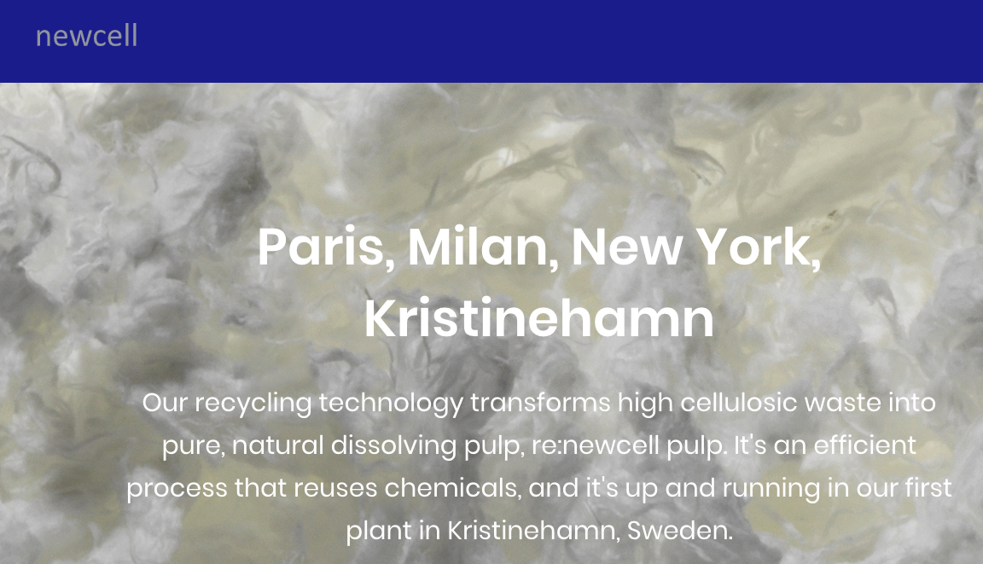
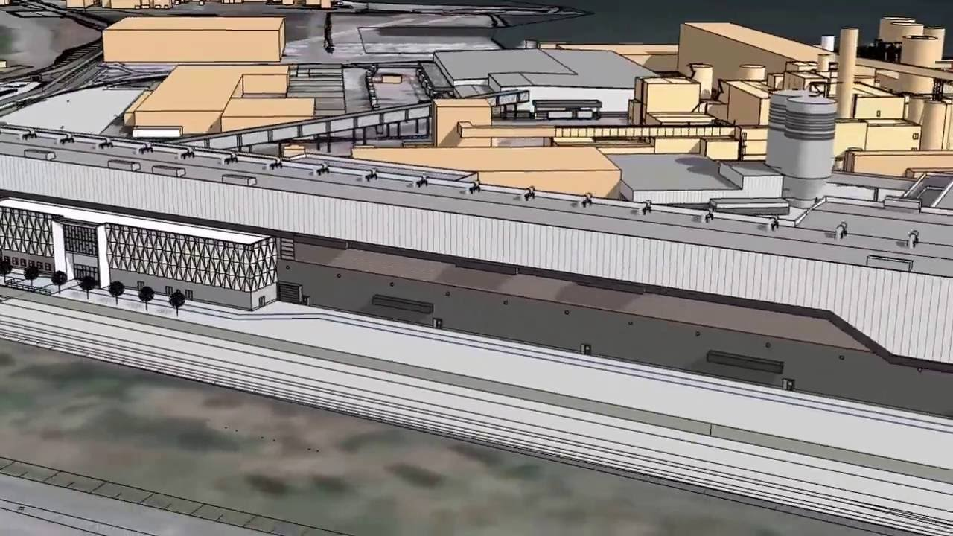
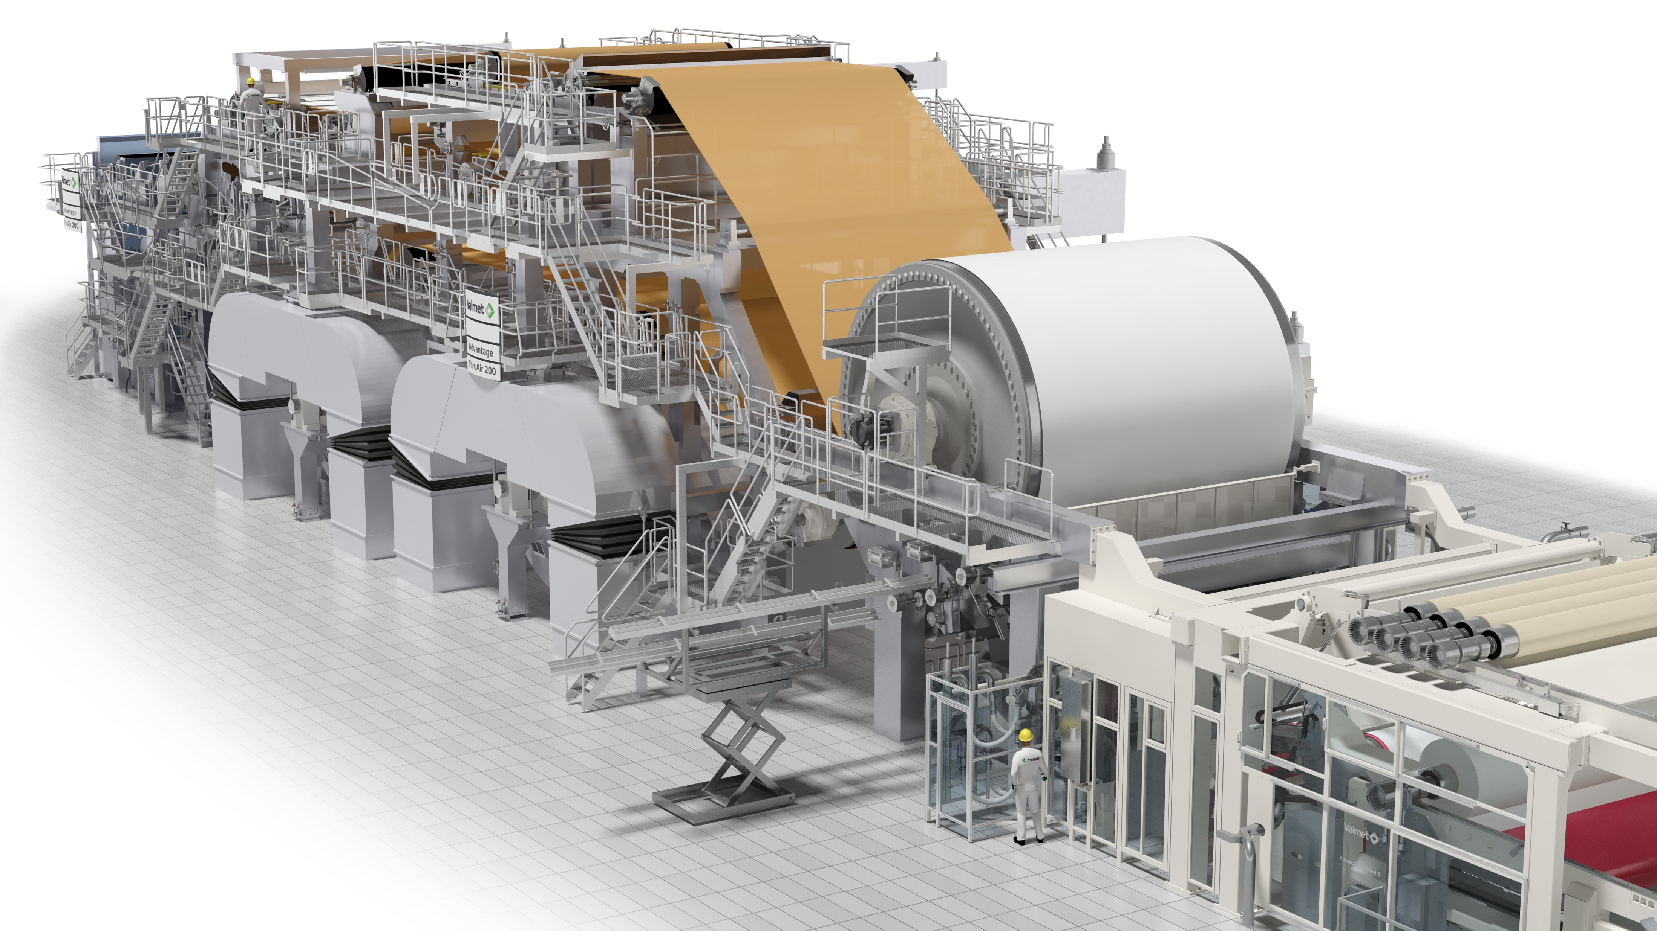
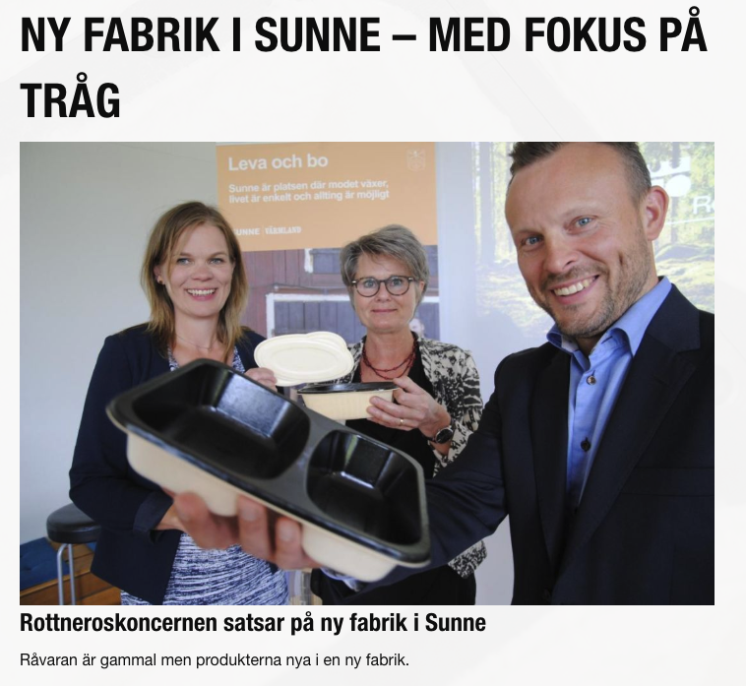
BillerudKorsnäs: 700 million USD board machine investment
Valmet: Advantage™NTT®
Notes:
Today there are big investments and success in the world market.
New industries and products related to forest industry.
Advantage™NTT®
BillerudKorsnäs: 5,7 miljarder i investering.
De styrkeområden som utmärker sig i styrka i Värmland är Papper, massa och förpackningsmaterial men också hela värdekedjan för förpackningar med dess starka innovationsmiljö kring dem.
Stål och verkstad är också en mycket tung industri, men inte alls lika stark. Här är det verkstadsindustrin som bjuder på utveckling och innovation. Det ses som ett tillväxtområde i Europa och bör så även vara för Värmland. Lovande för framtiden är kopplingar till miljöteknikutveckling där vi ser möjligheter för smart specialisering.
Solel är ett styrkeområdet ligger rätt i tiden och har stor utvecklingspotential vilket gör det till ett lovande smart specialiseringsområde som måste hitta sin nisch för att tackla den hårda konkurrensen internationellt.
IT och Telekom är ett betydligt mindre styrkeområde som lidit av konkurrens från Asien. Det har dock en intressant spets inom hälsa som är starkt kopplad till tjänsteinnovation och hälsa. Ett annat styrkeområde som utmärker sig i styrka och som visar stark potential är Tjänsteforsking och tjänstefiering. Här har regionen mycket att vinna på fortsatt samverkan, inom och mellan styrkeområden. Vi ser att det här styrkeområdet kan bidra starkt till smart specialisering av andra styrkeområden speciellt vid koppling till vården och hälsa men också andra starka områden.

Slide 27
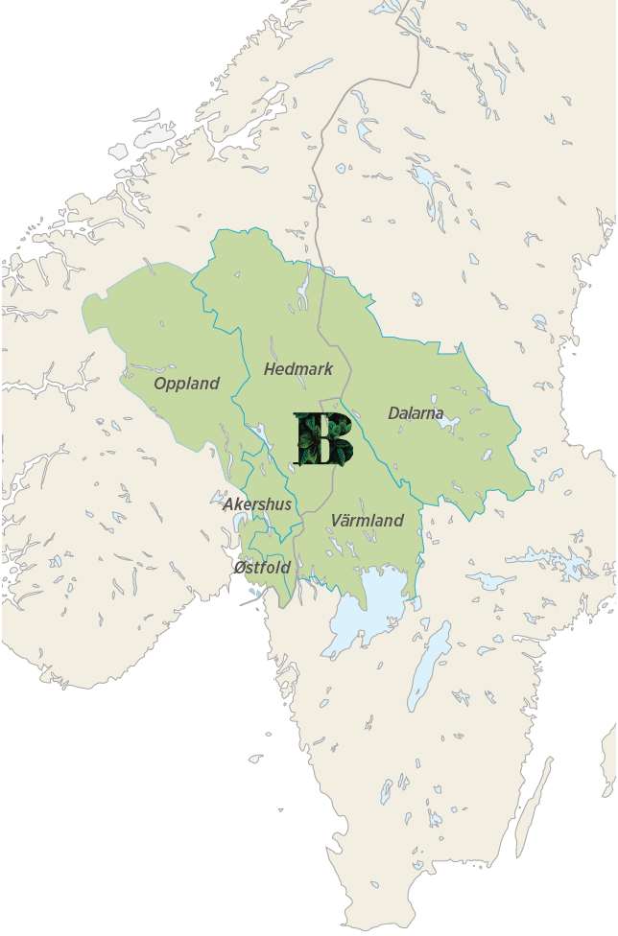
Notes:
We can see that we are attractive in a bigger geography. The neighbour regions wants to be hang around.
Our strategy is to be more attractive and to connect to knowledge development, knowledge flows, investments etc in other regions within this area.

Slide 28
Notes:
Industrial Partners 10 000 $/year.

Slide 29
Industrial
Partners
And more to come…
Notes:
Visuellt – Illustrationer SISP

Slide 30
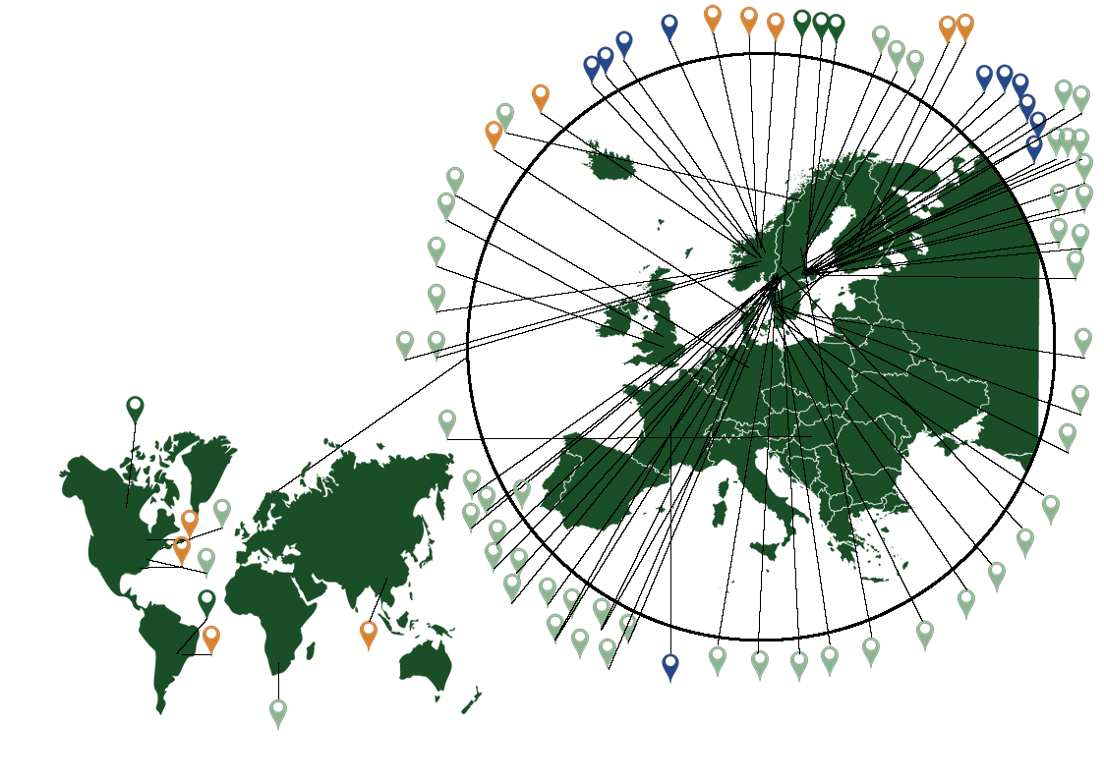
World
Presence
Case from, for example:
Värmland
Stockholm
Sundsvall
Gothenburg
Helsingborg
Varberg
Västerås
Västervik
Uppsala
Trollhättan
Falun
Borås
Outside of Sweden: Norway Great Britain
United States
Hungary
Germany
Finland
Case
Finance
Partner
Soft Partner

Slide 31
New bransches from old
Diversification through smart specialisation
Cellcomb
Modvion
Mykorena
Melker af Sysslebäck
Re:newcell
Notes:
Alla exemplen har en koppling till skogs- / pappersindustrin.
Det är fr a på det här sättet vi kan skapa nya jobb.

Slide 32
BASF
Ludvigshafen
Notes:
BASF Ludvigshafen.
FSC-labeled nordic forests
Vi behöver tänka över hur vi vill stötta vilken väg vi ska gå för användningen av vår skogsråvara.
Jämför med hur vår skogsindustri valde bort tryckpapper för ett antal år sedan för att istället producera board och andra produkter med högre förädlingsvärde.

Slide 33
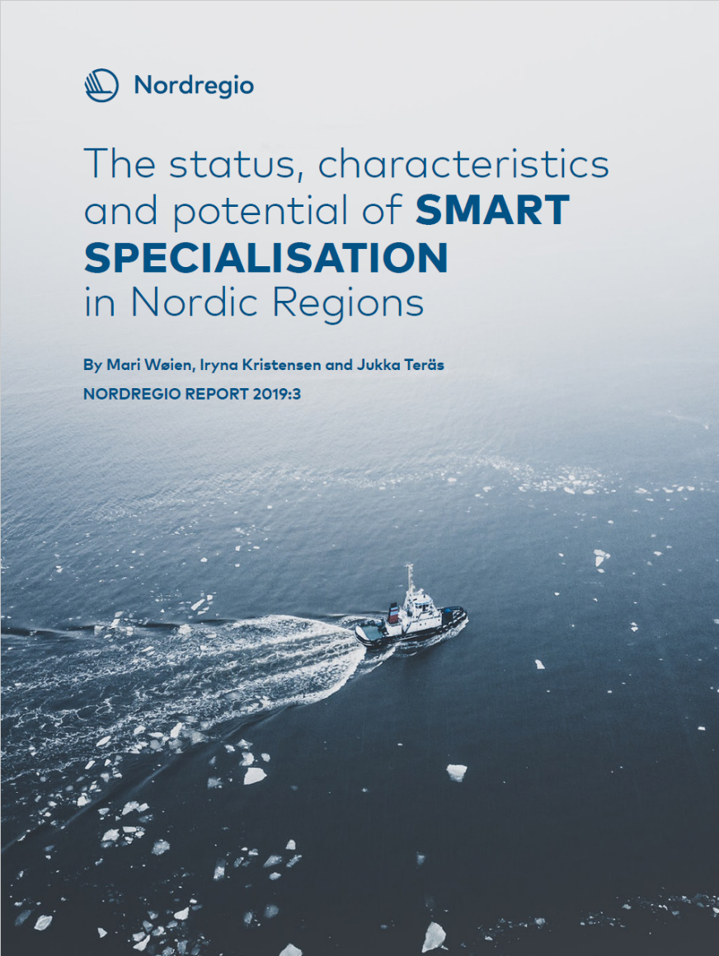
Implementing Smart Specialisation: Experiences from Nordic regions
Nordregio Forum 2019
Smart Specialisation in Nordic regions
Mari Wøien Meijer

Slide 34
Background
Nordic Thematic Working Group for Innovative and Resilient Regions 2017 – 2020 → Policy recommendation for Nordic regions in 4 areas:
Resilience
Digitalisation
Smart Specialisation
Skills policies (discussion paper)
Funded by Nordic Thematic Groups under the Nordic Council of Ministers’ Committee of Civil Servants for Regional Affairs.
Smart specialisation
Skills policies
Resilience
Digitalisation

Slide 35
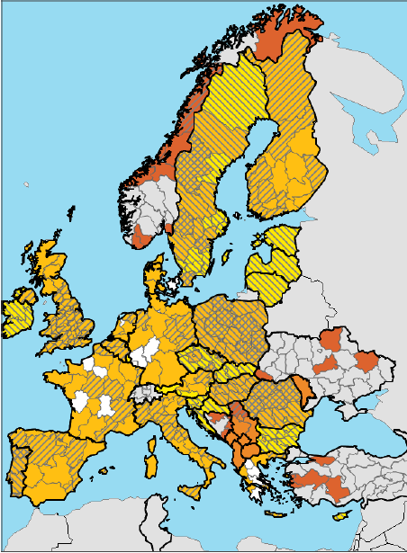
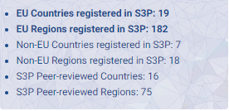
What is Smart Specialisation (S3)?
Dominique Foray (2009) developed and the coined the concept: Not a new concept in and by itself, but a systemised, scaled up take on entrepreneiurial development.
Key concepts: Entrepreneurial discovery process and domains
A measure to ensure the competitiveness of innovation and development in the EU in relation to e.g. the USA.
Ex-ante conditionality in the EU to receive ERDF funding in the current programme period.
A regionalisation of R&D&I efforts
Exists outside of the EU
35
35
03/09/2018
03/09/2018

Slide 36
Empirical research:
Case study selection:
1. Represent a diverse set of regional typologies
2. Identified approaches to smart specialisation, or de facto smart specialisation
3. Allow for cross-case analysis
The research is based on:
Desktop research
Semi-structured interviews with key stakeholders
Cross-case analysis and benchmarking

Slide 37
Research questions
RQ (1) How do the national and regional governmental levels support S3 processes and which tools are in place for this purpose?
RQ (2) What are the enabling and impeding factors influencing the adoption of S3 elements at the regional level?
RQ (3) To what extent does the S3 approach aid the understanding of the relevant processes in regional innovation systems and the stimulation of necessary synergetic co-operation within them?
RQ (4) As a place-based approach, how does S3 contribute to driving the green growth agenda in the Nordic context?
Notes:
Basically, what does S3 look like in Nordic regions and what can be learnt from the existing processes? (both about S3 as a strategy in itself and what it means in the Nordic context)
It is important to note that this report is subject to limitations. Although the Nordic Region seem comparable on the surface, the countries differ in a number of different ways. This includes culture, innovation systems, industrial history and politics. As such, the report’s starting point is from a framework based on contextualised comparisons (Locke and Thelen, 1995). Despite these differences, there still seem to be lessons learned through good practices across the countries formatted to fit the context of the country in question.
The study is also replying on a limited sample of regions, and with only one region from each country (except Finland: Kymenlaakso and Åland), the report is not intended to make generalisations for the countries at large.

Slide 38
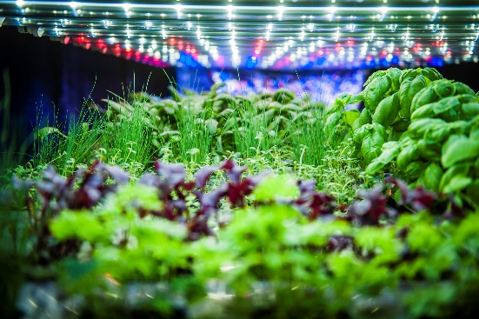
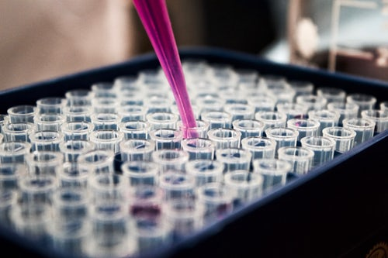
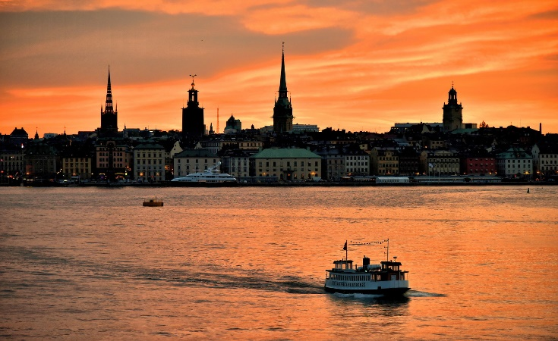
Case study 1: Stockholm, Sweden
‘It would be easier in a smaller town as it is easier to find the right partners to collaborate with, focus and mobilise for a common cause. This is what you usually would call the ‘big city’ problem. It is difficult.’
(Interview S2)

Slide 39
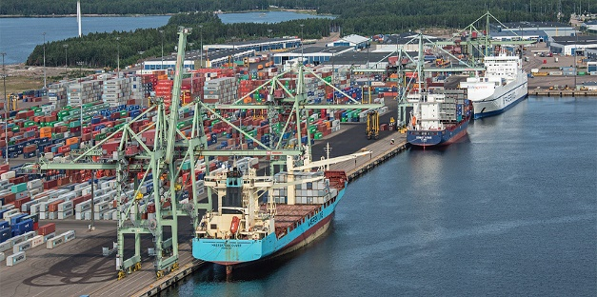
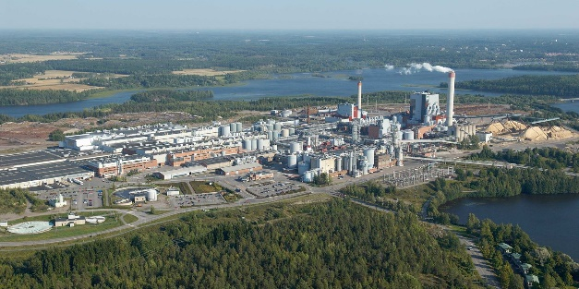
Case study 2: Kymenlaakso, Finland
‘Kymenlaakso S3 process was an important impulse towards creating a common regional vision about our long-term strengths and joint opportunities. It was a first attempt to comprehensively understand our real strengths and joint possibilities.’
(Interview K3 & K5)

Slide 40
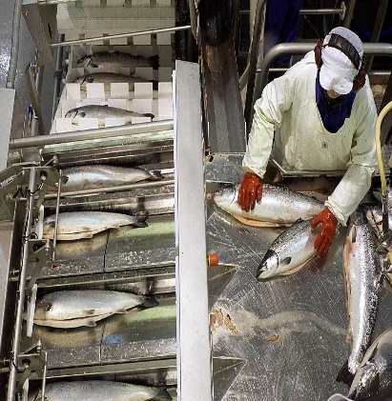
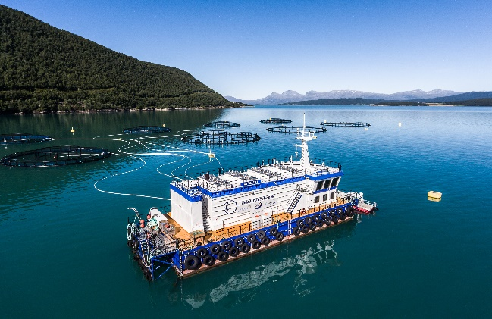
Case study 3: Nordland, Norway
‘Most financial instruments are connected to the national level today. But there are suggestions that the regional reform will transfer quite a few of these instruments to the regional level for the regions to have a broader set of responsibilities in regional development. The challenge is that we have so few instruments when creating an S3 strategy when it requires a policy mix and a multilevel governance structure.’ (Interview N4)

Slide 41
Nordic S3: Key findings
S3 - strong regardless of ex ante.
Ex ante cases - often pragmatic rather than willed
Advanced S3 cases have hit the ground running and use it for catalysing change → de facto S3
Communication of added value to incentivise, engage and mobilise actors
Enabling factors: Social capital, transregional knowledge sharing, existing innovation structures
Impeding factors: Actor engagement, ‘optimal size’, lack of ownership → mandate.
Regions as platforms for networking and catalyzing change, but limited by relative regional power to operationalise the concept
Green perspectives often included by default → S3 adds additional incentives to enforce change.

Slide 42
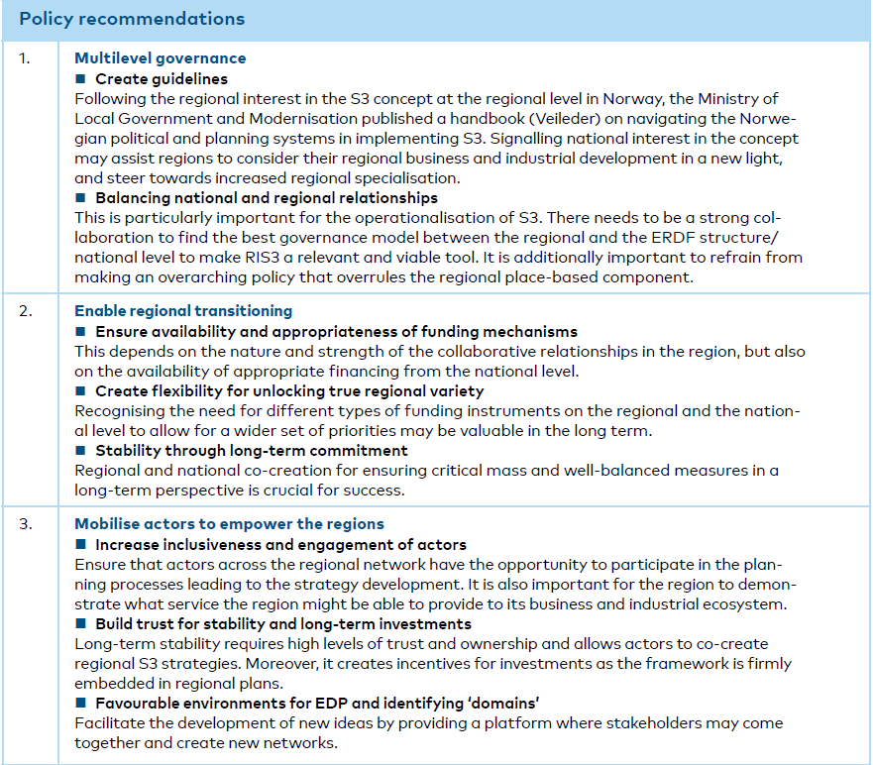
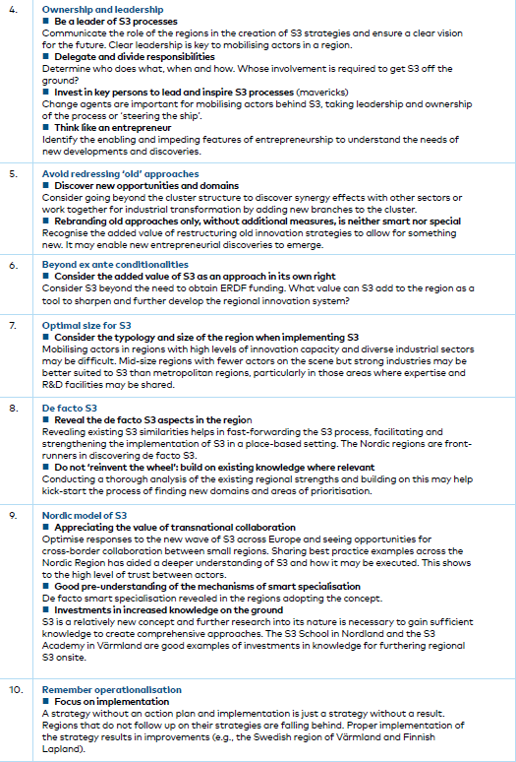
Policy recommendations …and the most important are perhaps:
Leadership/ownership and coordination
Support from the national level for regional operationalisation
Avoid redressing old approaches only → S3 is not old industrial politics in disguise
But do not reinvent the wheel → Discover ‘de facto S3’ constellations in the existing regional processes
Operationalisation: A strategy without an action plan is a strategy without result. And that is neither smart nor special…

Slide 43
Next steps: Spreading the word!
Thematic Roadshows:
Ministry of Local Government and Modernisation, Oslo, Norway
Skolkovo School of Management, Moscow, Russia
RSA Conference 2019, Santiago de Compostela, Spain
Nordregio Forum 2019
Next: Somewhere in your region or organised by you?
Finally: Possible implications on the next EU programme period?

Slide 44
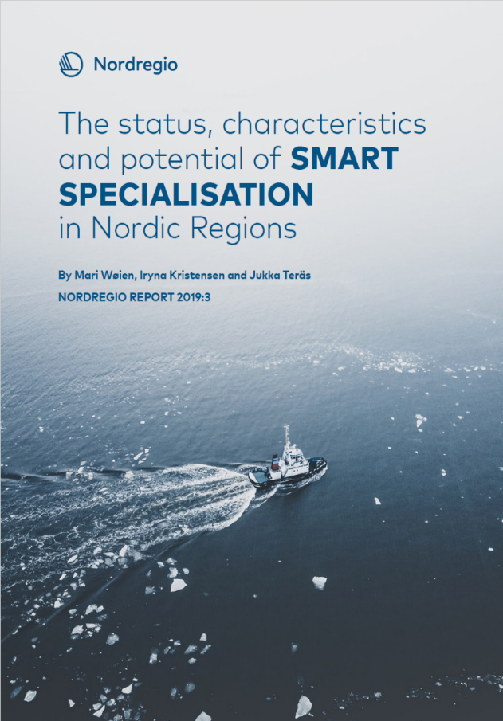
Want to know more?
Wøien, M., Kristensen, I., & Teräs, J. (2019). The status, characteristics and potential of SMART SPECIALISATION in Nordic Regions. Available at:
http://norden.diva-portal.org/smash/record.jsf?pid=diva2%3A1295018&dswid=189
Or the shorter version (policy brief):
Wøien, M. and Teräs, J. (2019) Implementing Smart Specialisation strategies in Nordic regions. Available at: http://norden.diva-portal.org/smash/get/diva2:1334482/FULLTEXT01.pdf

Slide 45
Mari Wøien Meijer
Research Fellow
mari.woien@nordregio.org
+46 760140142
Nordregio
Holmamiralens väg 10, 111 49 Stockholm, Sweden

Slide 46
Þakka þér fyrir! (or: Thank you!)

